Slide 1


DIAGNOSIS OF DIABETIC RETINOPATHY
25-1-R-11
Lital Haibetov & Katrin Frimus
Supervisor: Miri Weiss Cohen

Slide 2
OVERVIEW
  Diabetes
  DR
  The problem
  The methodology
  DenseNet and Transfer learning
  Proposed research – Database, Hyper patameters, Gui
  Tests

Slide 3
INTRODUCTION
  Diabetes is a chronic condition
  is the 4th leading cause of death
  High blood sugar may damage nerves and blood vessels

Slide 4
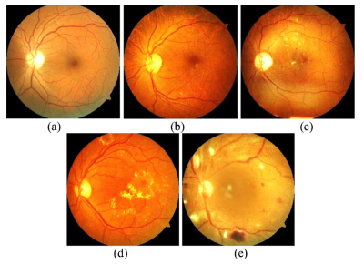
DIABITIC RETINOPATHY (DR)
    A common severe complication of diabetes
    5 stages: NPDR – PDR (proliferative DR)
    Can cause blurry vision , blindness
    By 2040, it is estimated that there will be 200 million cases of diabetic retinopathy globally.

Slide 5
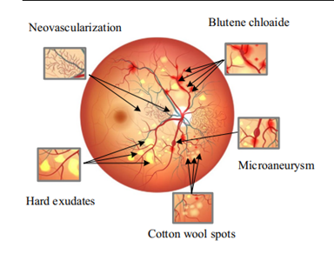
PROBLEM
  Screening takes time (1–2 days).
  Not enough eye doctors to analyze scans.
  Limited medical equipment in some areas.
  DR does not have early signs

Slide 6
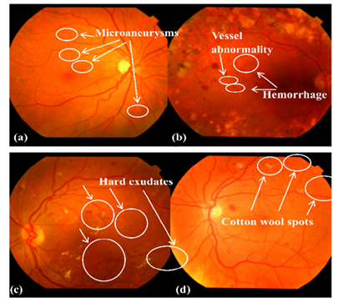
METHODOLOGY
  Create an automated system using deep learning to detect and classify retinal lesions
  Based on DenseNet

Slide 7
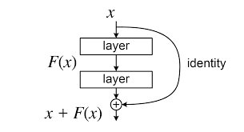
METHODOLOGY
DenseNet – more accurate and efficient to train
Regular neural Network issue with the vanish gradient problem
DenseNet is an extension of ResNet.
ResNet introduce the skip connection
DenseNet combine parameters by concatenating instead of summing
DenseNet layers are very narrow

Slide 8
DenseNet Structure
Dense block, transition layer, Convolution layer and fully connected layer
Dense Block consists of multiple layers that each of them applies composite function.
Composite function : Batch Normalization (BN) , rectified linear units (ReLU) and a 3X3 Convolution (Conv).
Grow rate: each composite function Hℓ produces k feature maps.

Slide 9
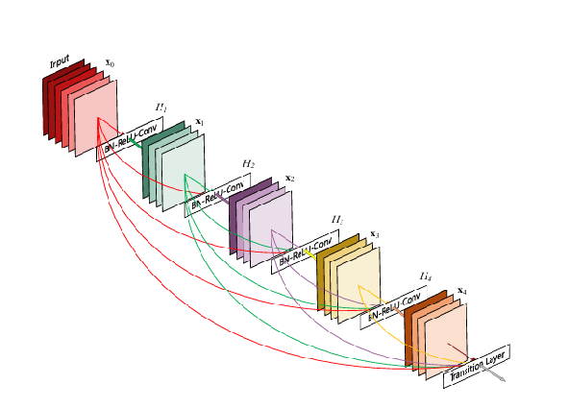
DenseNet Structure
Dense Block

Slide 10
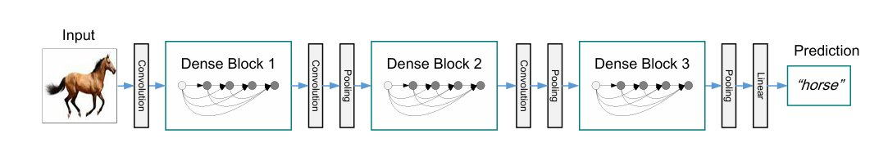
DenseNet Structure
Transition layer & fully connected
Transition layer consist of 1X1 convolutions layers and 2X2 max pooling
fully connected and softmax

Slide 11
DenseNet Enhancements
DenseNet-B: denseNet that uses a Bottleneck layer to reduce feature channels and reduce computational cost with a 1×1 convolution.
DenseNet-C: denseNet that uses a compression to reduce the number of feature channel with compression factor.
Notes:
A Bottleneck Layer in DenseNet reduces computational cost by applying a 1×1 convolution before a 3×3 convolution, decreasing the number of feature channels and improving efficiency without losing important information.
Compression reduces the number of feature channels in transition layers using 1×1Convolution with a compression factor θ, preventing computational growth and maintaining an efficient network.

Slide 12
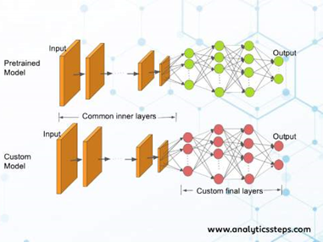
Transfer learning
Transfer learning (TL) is a technique where a model pre-trained on a new relate problem.
known as fine-tuning
2 types of layers: Frozen layers and Modifiable layers.
  Frozen layers left alone during retraining
  Modifiable layers retrained during fine-tuning

Slide 13
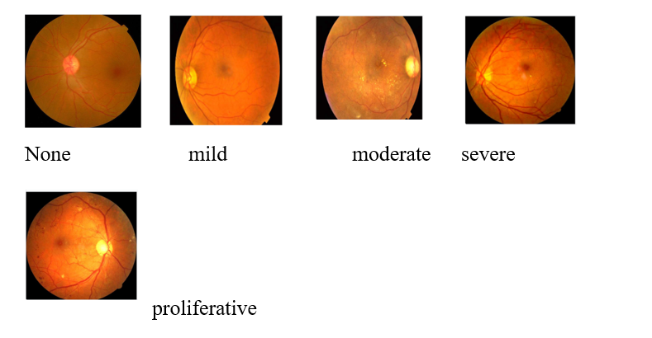
Dataset
Datasets: Eyepacs, Aptos, Messidor
Split: 80% train, 10% validation, 10% test
Total images after augmentation: 143,669

Slide 14
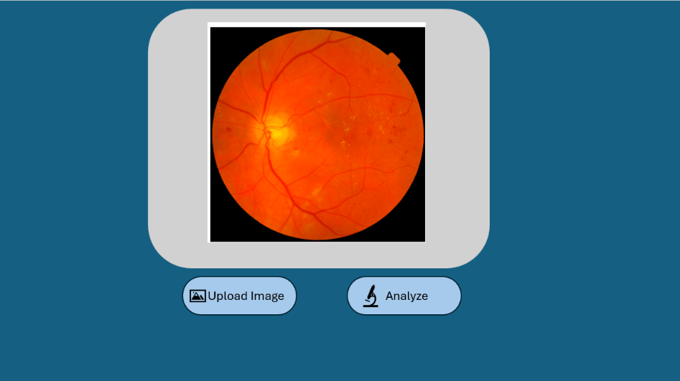
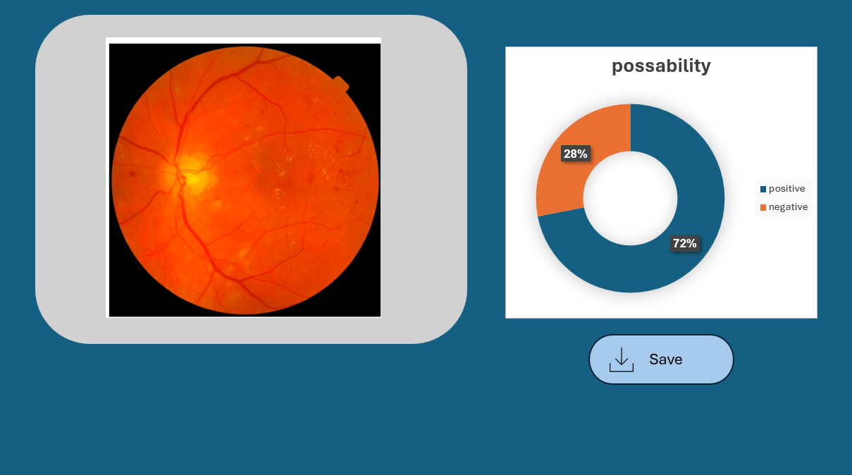
GUI

Slide 15
Hyper parameters
• Learning rate {0.00005 – 0.0000005}
• Epochs {50, 100, 150}
• Batch size {32, 64}
• Dropout {0.2-0.5}
Evaluation metrics (TP, TN, FP, FN)
Accuracy=(TP + TN )/(TP + TN + FP + FN)
Precision=TP/(TP+FP)
Recall=TP/(TP+FN)

Slide 16
Challenges
• We lacked medical knowledge about DR
Deep learning and neural networks were new to us

Slide 17
Test
Expected Result | Case Test | Case number
Error: "Please upload an image for analysis" | Press 'Analyze' without uploading an image | 1
Error: "Invalid file format" | Upload an unsupported file | 2
Image appears in the preview window | Upload a correct image format | 3
The program shows percentage of possibility | Press 'Analyze' for an image with diabetic symptoms | 4
Error: "File size too big " | Upload a large image file | 5
Error:" Fail, try different picture" | Program fail to predict | 6

Slide 18
REFERENCE
Link Name: Densely Connected Convolutional Networks
﻿Brief Description: article about densenet
Link Name: BuiltIn
﻿Brief Description: Transfer learning
Link Name: Diabetic retinopathy detection and stage classification in eye fundus images
﻿Brief Description: article about DR

Slide 19
Thank You
For your attention

